Slide 1
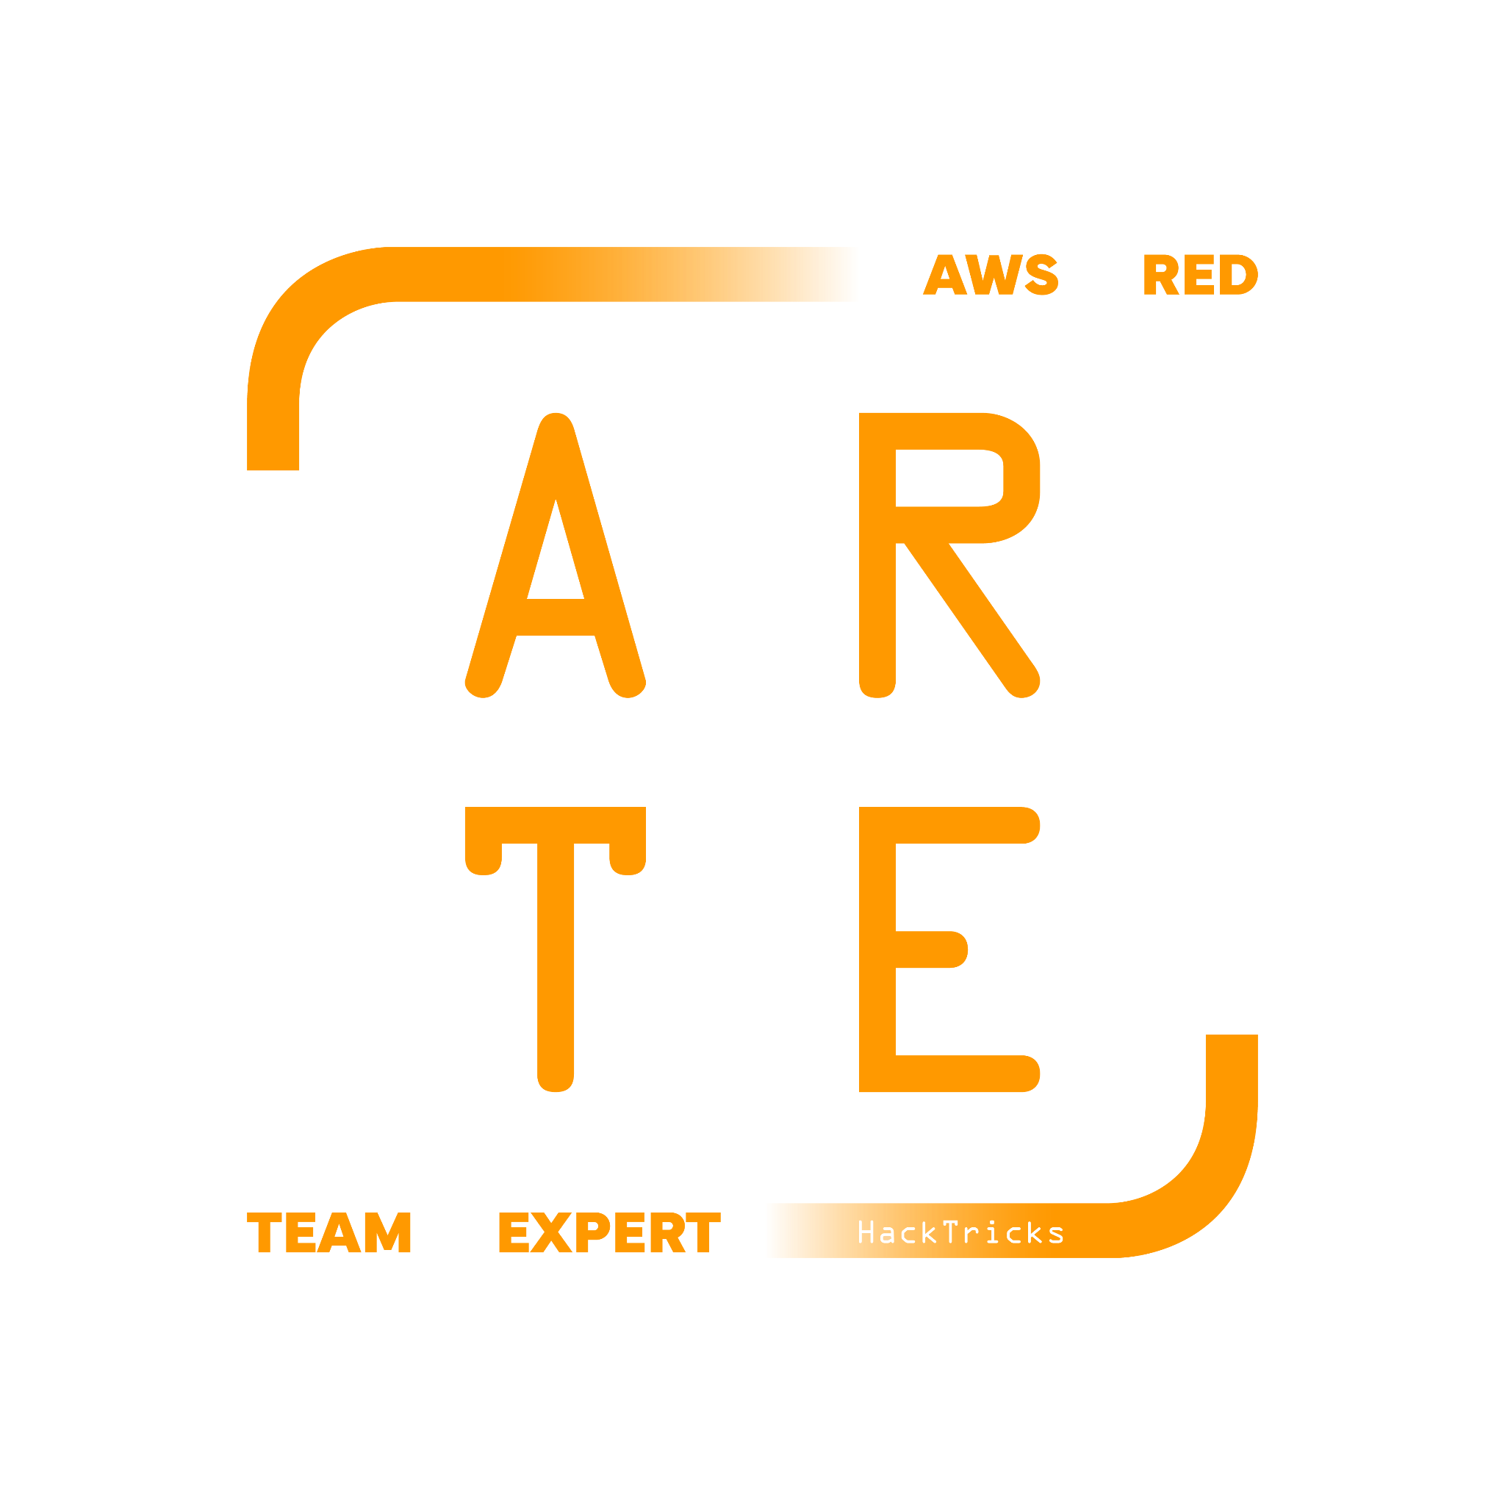
RDS Relational Database Service
HackTricks Training
https://t.me/CyberFreeCourses

Slide 2
Basic Information
Relational Database Service (RDS) is a managed database service that simplifies the process of setting up, operating, and scaling a relational database in the cloud. AWS RDS provides cost-efficient and resizable capacity, and it automates time-consuming administration tasks, such as hardware provisioning, database setup, patching, and backups.
AWS RDS supports several popular relational database engines: MySQL, PostgreSQL, MariaDB, Oracle Database, Microsoft SQL Server & Amazon Aurora compatible with MySQL or with PostgreSQL.
With RDS, you can easily manage database instances, create read replicas to increase read performance, and set up multi-Availability Zone (AZ) deployments for high availability and failover support. Additionally, RDS integrates with other AWS services, such as AWS Identity and Access Management (IAM) for access control, AWS CloudWatch for monitoring and metrics, and AWS Key Management Service (KMS) for encryption at rest.
https://t.me/CyberFreeCourses
https://cloud.hacktricks.xyz/pentesting-cloud/aws-security/aws-services/aws-relational-database-rds-enum

Slide 3
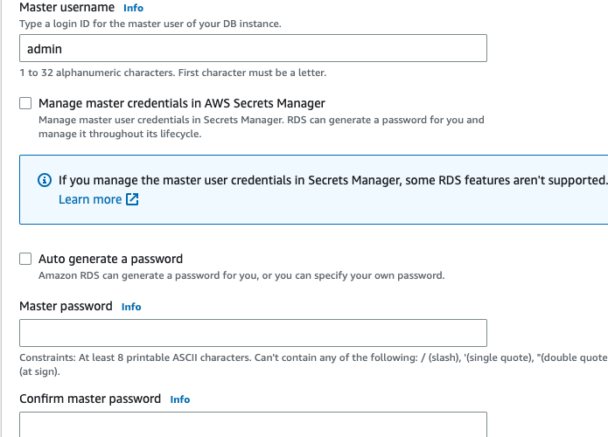
RDS DB Credentials
When creating the DB cluster the master username can be configured (admin by default). To generate the password of this user you can:
Indicate a password yourself
Tell RDS to auto generate it
Tell RDS to manage it in AWS Secret Manager encrypted with a KMS key
https://t.me/CyberFreeCourses
https://cloud.hacktricks.xyz/pentesting-cloud/aws-security/aws-services/aws-relational-database-rds-enum

Slide 4
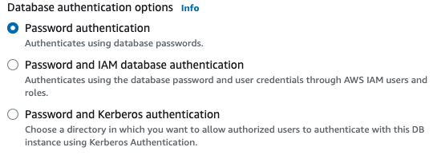
RDS Authentication
There are 3 types of authentication options, but using the master password is always allowed:
https://t.me/CyberFreeCourses
https://cloud.hacktricks.xyz/pentesting-cloud/aws-security/aws-services/aws-relational-database-rds-enum

Slide 5
Public Access & VPC
By default no public access is granted to the databases, however it could be granted. Therefore, by default only machines from the same VPC will be able to access it if the selected security group (are stored in EC2 SG) allows it.
Instead of exposing a DB instance, it’s possible to create a RDS Proxy which improves the scalability & availability of the DB cluster.
Moreover, the database port can be modified also.
https://t.me/CyberFreeCourses
https://cloud.hacktricks.xyz/pentesting-cloud/aws-security/aws-services/aws-relational-database-rds-enum

Slide 6
Encryption
Encryption is enabled by default using an AWS managed key (a CMK could be chosen instead).
By enabling encryption, you are enabling encryption at rest for your storage, snapshots, read replicas and your back-ups. It's not possible to add this level of encryption after your database has been created. It has to be done during its creation.
However, there is a workaround allowing you to encrypt an unencrypted database as follows. You can create a snapshot of your unencrypted database, create an encrypted copy of that snapshot, use that encrypted snapshot to create a new database, and then, finally, your database would then be encrypted.
https://t.me/CyberFreeCourses
https://cloud.hacktricks.xyz/pentesting-cloud/aws-security/aws-services/aws-relational-database-rds-enum

Slide 7
Manual Enumeration
# Clusters info
aws rds describe-db-clusters #IAM enabled? public? port? SG?
aws rds describe-db-cluster-endpoints #Cluster URLs
aws rds describe-db-cluster-backtracks --db-cluster-identifier <cluster-name>
## Cluster snapshots
aws rds describe-db-cluster-snapshots
# Get DB instances info
aws rds describe-db-instances #username? url? port? vpc? SG? public?
aws rds describe-db-security-groups
## Find automated backups
aws rds describe-db-instance-automated-backups
## Find snapshots
aws rds describe-db-snapshots
aws rds describe-db-snapshots --include-public --snapshot-type public
## Restore snapshot as new instance
aws rds restore-db-instance-from-db-snapshot --db-instance-identifier <ID> --db-snapshot-identifier <ID> --availability-zone us-west-2a
# Proxies
aws rds describe-db-proxy-endpoints
aws rds describe-db-proxy-target-groups
aws rds describe-db-proxy-targets
## reset credentials of MasterUsername
aws rds modify-db-instance --db-instance-identifier <ID> --master-user-password <NewPassword> --apply-immediately
https://t.me/CyberFreeCourses
https://cloud.hacktricks.xyz/pentesting-cloud/aws-security/aws-services/aws-relational-database-rds-enum

Slide 8
Unauth Access
Public Port
A DB could be exposed to the internet
Public snapshot
A snapshot of a RDS could be made public so anyone with an AWS account can download it
https://t.me/CyberFreeCourses
https://cloud.hacktricks.xyz/pentesting-cloud/aws-security/aws-unauthenticated-enum-access/aws-rds-unauthenticated-enum

Slide 9
Privilege Escalation
DEMO
rds:ModifyDBInstance
Modify the password of the master user
Abuse RDS IAM role to access S3
https://t.me/CyberFreeCourses
https://cloud.hacktricks.xyz/pentesting-cloud/aws-security/aws-privilege-escalation/aws-rds-privesc
Notes:
aws --profile myadmin rds describe-db-clusters
aws --profile myadmin rds describe-db-cluster-endpoints
# Postgres
psql --host=database-1-instance-1.cvjzyw16ubgo.eu-west-1.rds.amazonaws.com --port=5432 --username=postgres --password 03eIUGYDEFowefug2ef2.f,o3wfr
// Create table
CREATE TABLE temp (col TEXT);
// Create s3 uri
SELECT aws_commons.create_s3_uri('test1234567890678', 'data.csv', 'eu-west-1') AS s3_uri \gset
// Load file contents in table
SELECT aws_s3.table_import_from_s3('temp', '', '(format text)',:'s3_uri');
// Get info
SELECT * from temp;
// Delete table
DROP TABLE temp;
# MYSQL
mysql -h database-2-instance-1.cvjzyw16ubgo.eu-west-1.rds.amazonaws.com -u admin -P 33336 -p 03eIUGYDEFowefug2ef2.f,o3wfr
show variables;

Slide 10
Post Exploitation
rds:CreateDBSnapshot, rds:RestoreDBInstanceFromDBSnapshot, rds:ModifyDBInstance
Create a DB with the snapshot of another DB to access the data
rds:ModifyDBSnapshotAttribute, rds:CreateDBSnapshot
Create a DB snapshot and make it public
https://t.me/CyberFreeCourses
https://cloud.hacktricks.xyz/pentesting-cloud/aws-security/aws-post-exploitation/aws-rds-post-exploitation

Slide 11
Persistence
Make database publicly accessible/Create a new cluster instance that is publicly accessible
Create a new admin user inside the DB/exfiltrate the credentials
https://t.me/CyberFreeCourses
https://cloud.hacktricks.xyz/pentesting-cloud/aws-security/aws-persistence/aws-rds-persistence

